Slide 1

D3.js
arman.heydari@usask.ca
CMPT 384 – Information Visualization
Lab 1
Course Instructor: Debajyoti Mondal
Lab Tutorial Instructor : Arman Heydari( arman.heydari@usask.ca )
The tutorial attendance is worth 5% of your final grade.

Slide 2

Agenda
Introduction (short)
Writing into console in browser
Random number generation in JS
Setup server using python
Read a CSV file (D3)
D3 basic steps
D3 chart circle draw
Input.csv
team,score
A,13
B,34
C,43
D,23

Slide 3
Assumptions …
• Have Heard Of “World Wide Web”, HTML, DOM, JavaScript and CSS
• Have A Little Programming Experience Already
• Aren’t Scared By Unknown Terms such as CSV, SVG, Or JSON
• WANT To Make Useful, Interactive Visualizations

Slide 4
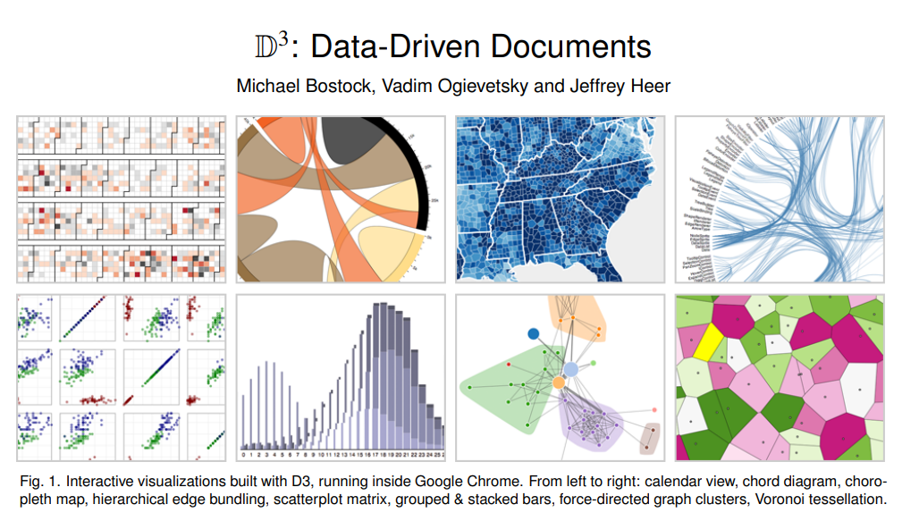
D3.JS
IEEE Transactions on Visualization and Computer Graphics
http://vis.stanford.edu/files/2011-D3-InfoVis.pdf

Slide 5




Visualizing with D3
This Photo by Unknown Author is licensed under CC BY-SA

Slide 6
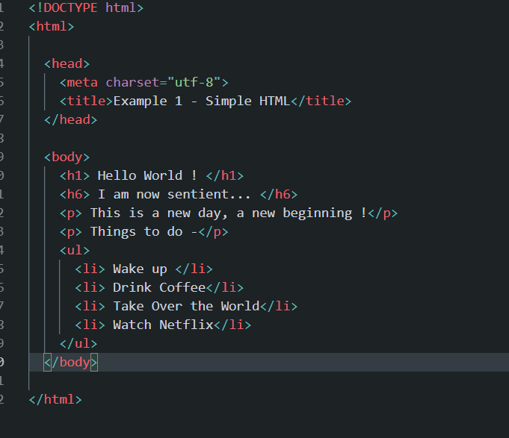
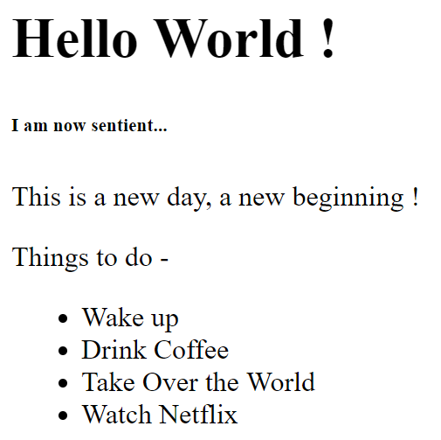
HTML
Describes the content on the page.

Slide 7
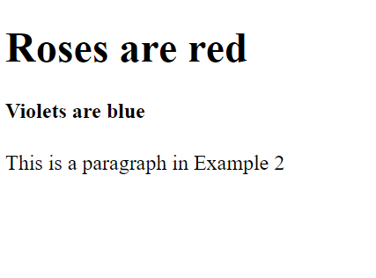
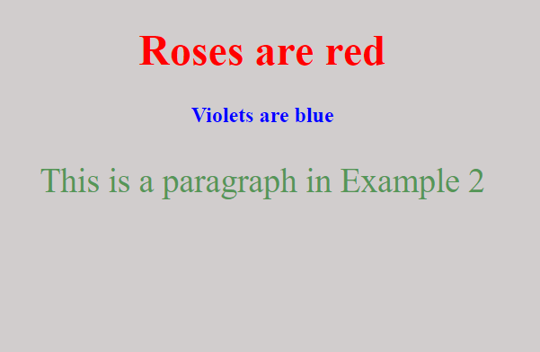
CSS
Describes how content should look on a webpage.

Slide 8
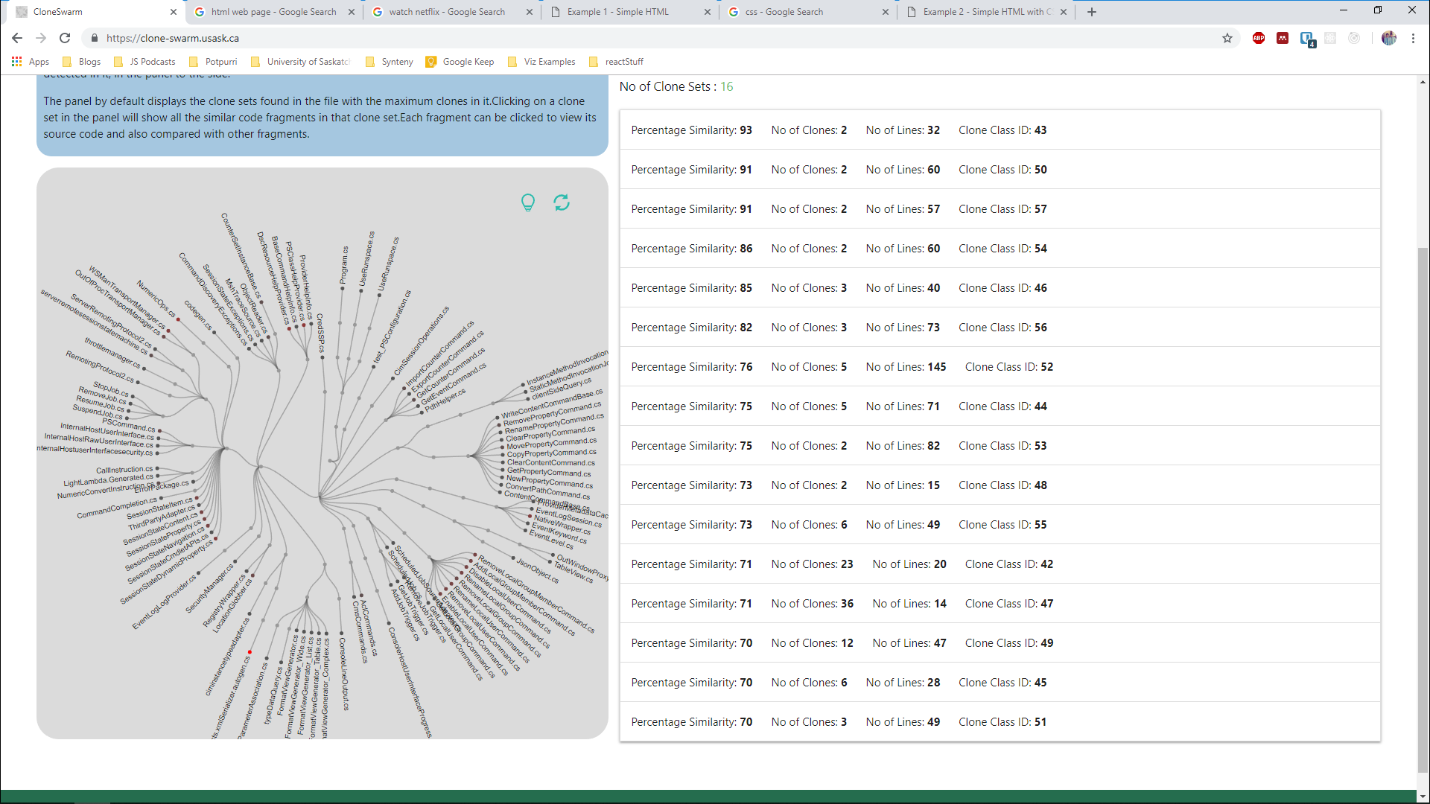
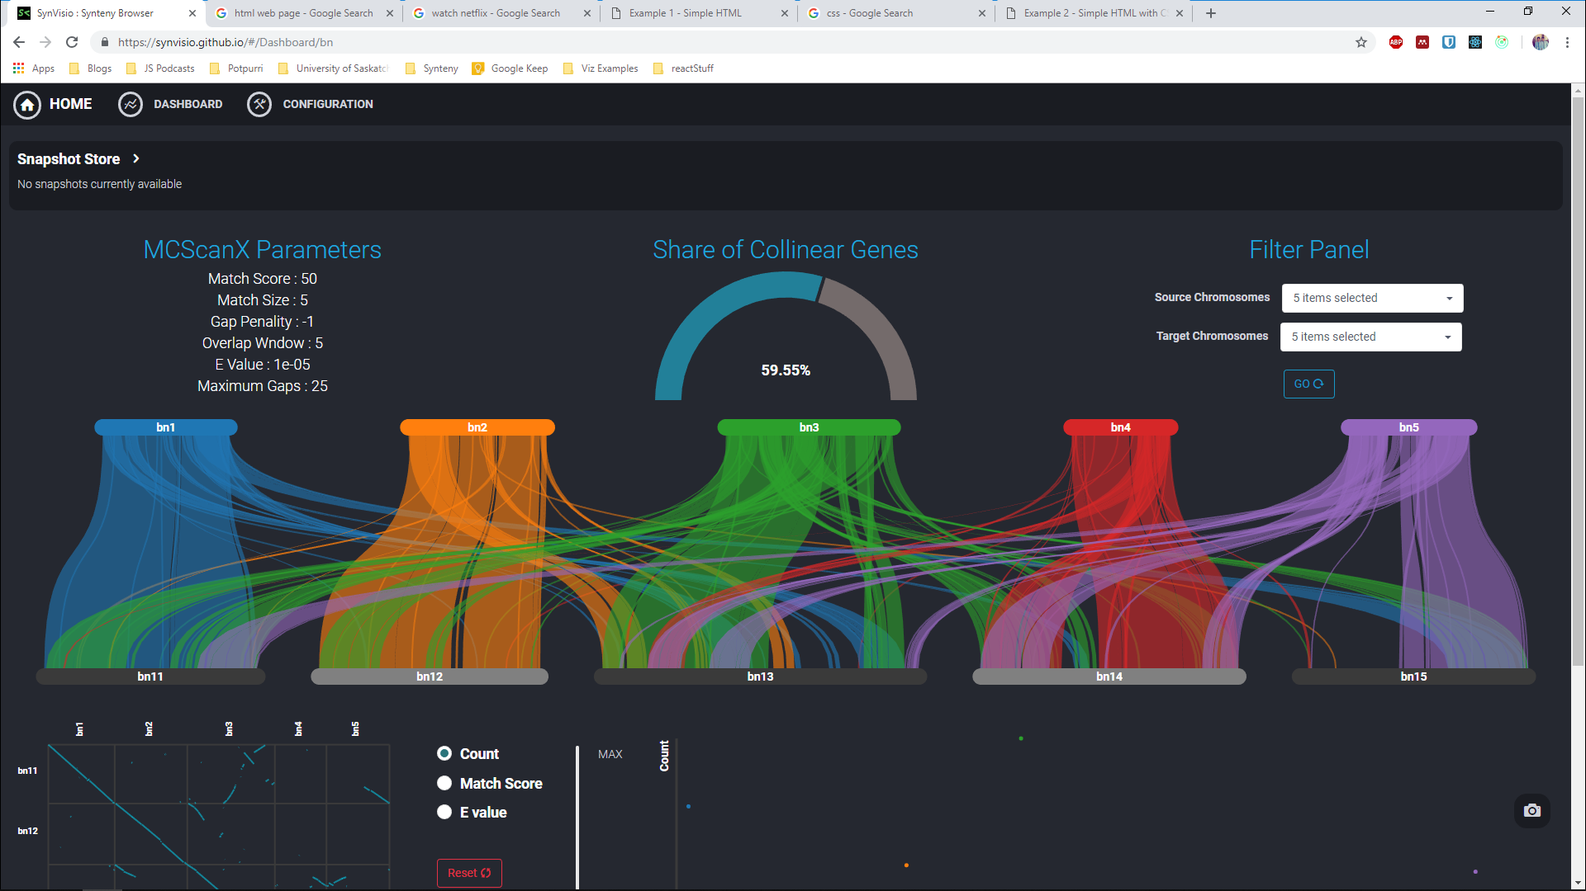
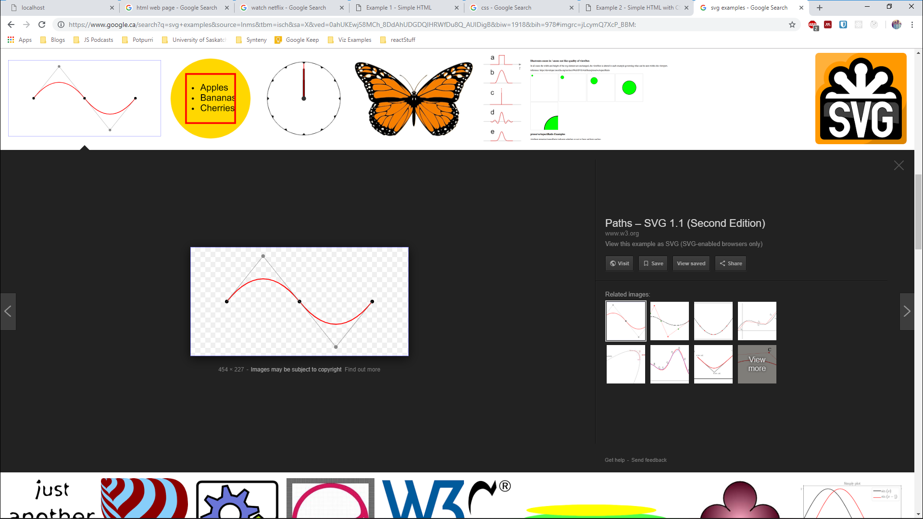
SVG
Vector images → defined by points, lines, and curves… mathematical equations

Slide 9
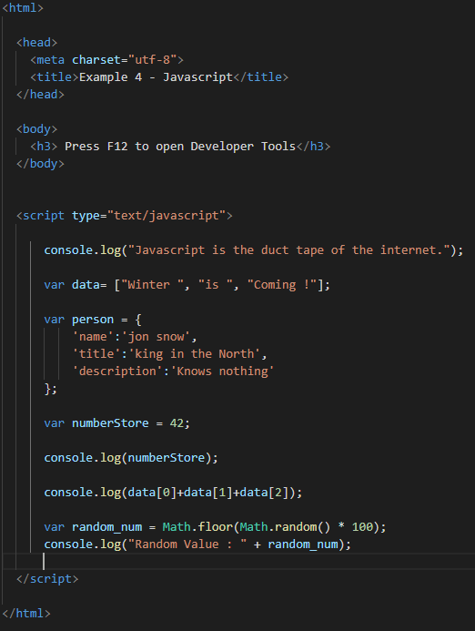
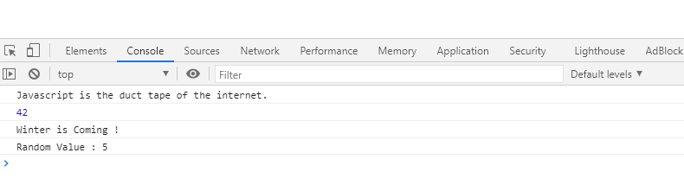
JavaScript – Example 4

Slide 10
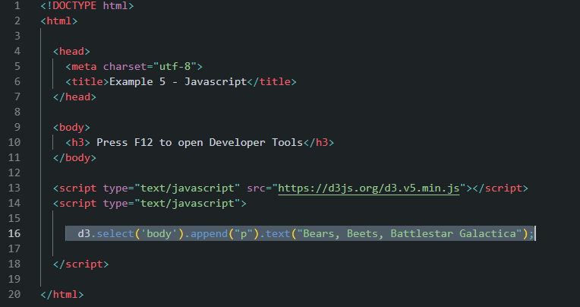
D3 – Example 5

Slide 11
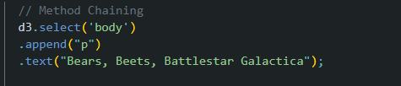
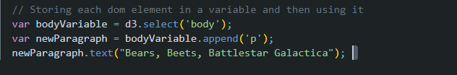
Method Chaining …
Method chaining lets you write shorter code (and waste less time fretting over variable names)
Try Modifying the text in the existing h3 tag into “Hello World”

Slide 12
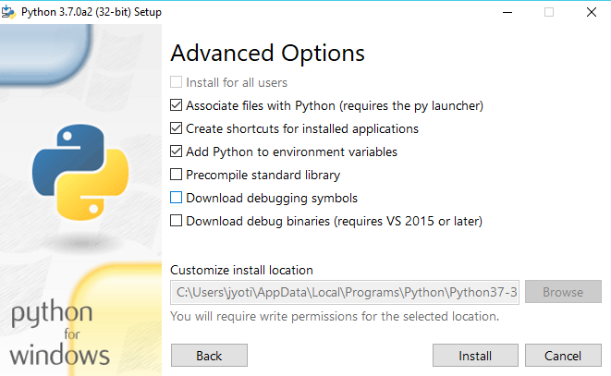
Working with Data … Frist things First: Create a server
Mac or Linux
- Python is already there
- Open the terminal
Windows
Install Python
Open the terminal

Slide 13
Start the Server
Microsoft Windows [Version 10.0.15063]
(c) 2017 Microsoft Corporation. All rights reserved.
C:\> python -m SimpleHTTPServer 8888
C:\Users\jyoti\AppData\Local\Programs\Python\Python37-32\python.exe: No module named SimpleHTTPServer
C:\> python -m http.server 8888
Serving HTTP on 0.0.0.0 port 8888 (http://0.0.0.0:8888/) ...

Slide 14
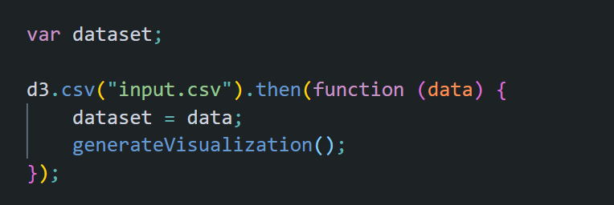
Example 6
Load Data using csv function in D3
Store data into global variable dataset , that can be accessed anywhere
Call function generateVisualization

Slide 15
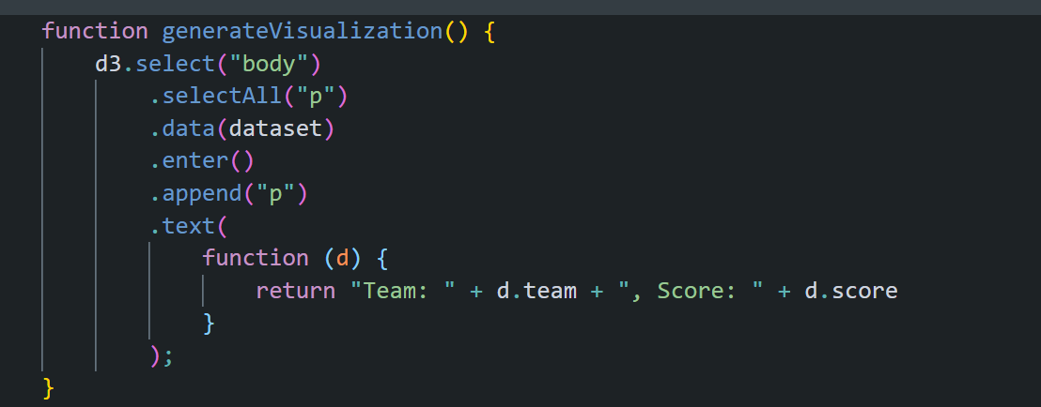
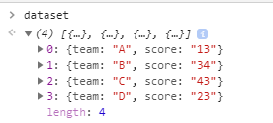
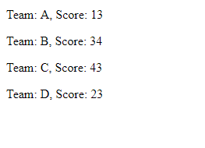
Example 6
The D3 enter – update – exit pattern will be explained in more detail in later classes

Slide 16
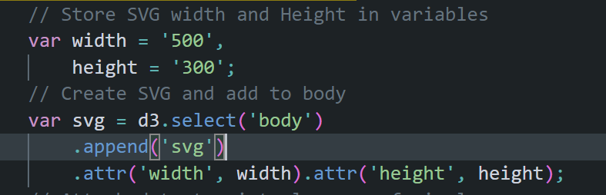
Creating a SVG
Store width and height values in variables
Get the body and attach a new SVG element to it
Set the width and height attributes
Store the SVG element in a variable

Slide 17
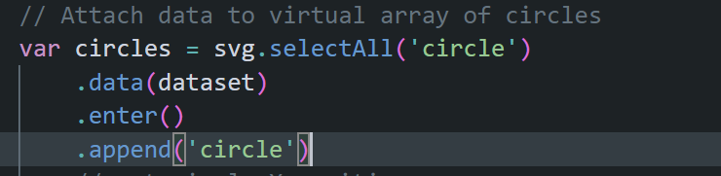
Creating a Set of Circles
selectAll function gets all the circles on the page
However, if there aren’t any it creates an empty virtual array
data function then binds the elements to the provided data array
So each value in the array dataset is now bound to one virtual element after the enter function
Then for each virtual element add an actual circle

Slide 18
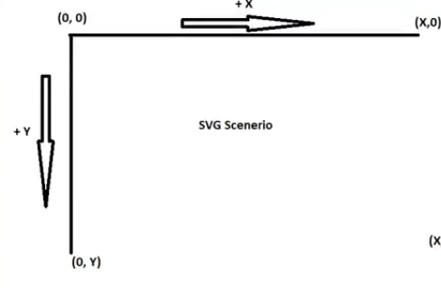
SVG coordinate system
The origin (0,0) is located at the top-left corner of the SVG canvas.

Slide 19
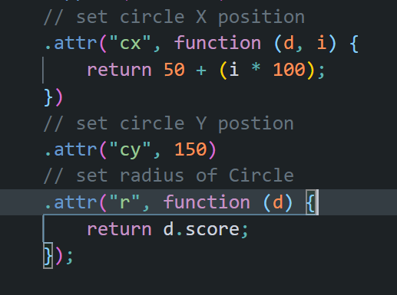
Creating a Set of Circles
For each circle
Set the X position based on the array index since circles are laid horizontally
Set the Y position constant so all circles are in the same level vertically
Set the radius based on the score, the d variable has an object which has both team name and score values, pick only score.

Slide 20
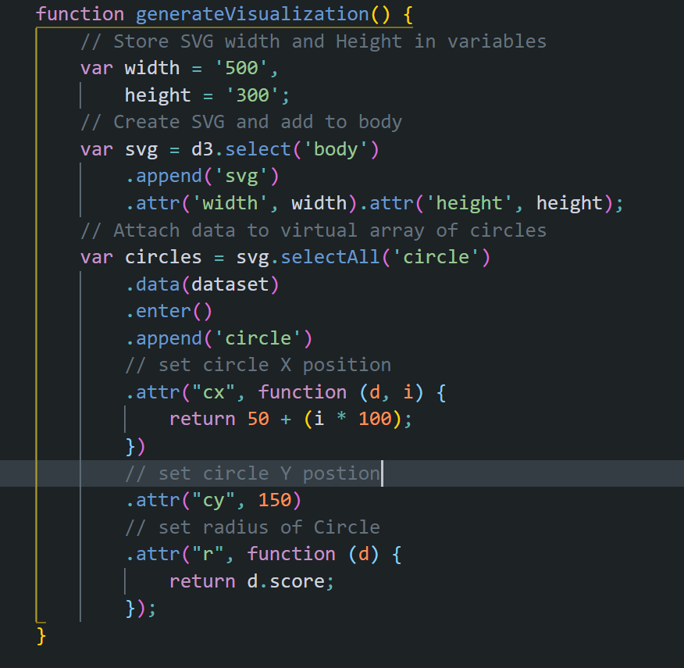
SVG Example
Input.csv
team,score
A,13
B,34
C,43
D,23
Try changing the code so circles are vertical instead of horizontal.

